Slide 1
Group 9 DeadPool Rush
Group Members:
Talha Ahmad (BSCS14022)
Ahmad Khalid (BSCS14037)
Abdul Rahim (BSCS14040)
Ahmad Ghumman (BSCS14061)

Slide 2
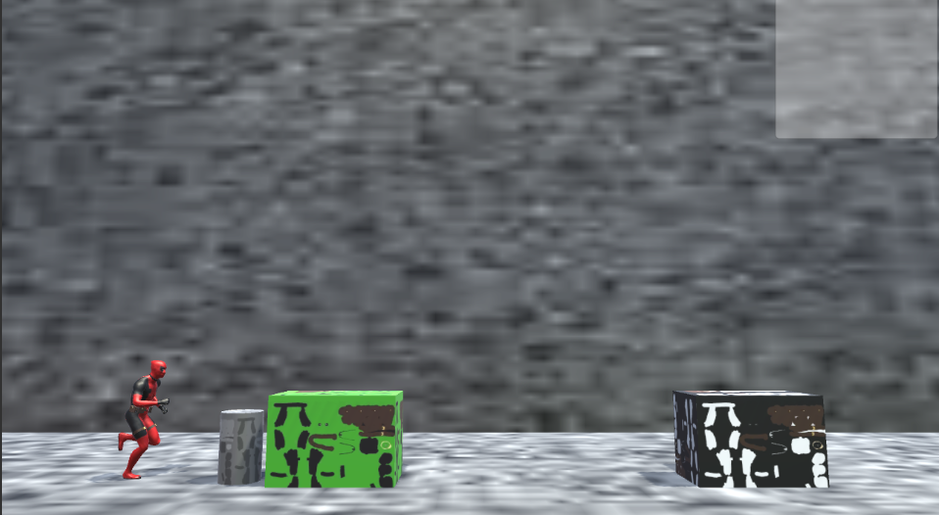
Introduction…
A simple 2.5D running Game.
Enemies and Obstacles on the way.
Guns and power-ups.

Slide 3
Screen interactions
Fire Button
Jump Button
Score
Powerup time
Weapon in hand
Special Attack Button

Slide 4
Techniques that will be used for requirement elicitation
Scenarios
Stakeholders will be given scenarios
E.g. Obstacle Touch or Enemy Fire Death
Coins or Gems
E.g. Whether the stakeholders want the character to die on touching obstacle twice.
Use cases
We’ll make use cases after getting feedback by stakeholders.

Slide 5
Functional Vs. Non-Functional Requirements
1- Game Scene 2- Quit Option. 3- Restart 4- Pause 5- Sound State (on/off). 6- Power Ups with Icons. 7- Game Assets. 8- Movements (jump, swing etc.) 9- Play again or Quit option at end. 10- 2.5d Environment
1- Game should load quickly - (in 10 sec) 2- High quality graphics. 3- Must not drop frame. 4- Minimum fps allowed is 25fps (Reliability) 5- Response time <= 0.5 Sec. (Speed) 6- Cover Android 4.0 and onwards. 7- No hidden extra memory (Size) 8- Resistant to crash states. (Reliability) 9- Progress in permanent memory.(Size)

Slide 6
Lenses of Game
The lens of Emotion :’)
The lens of Surprise O.o
The lens of Fun :D
The lens of Curiosity :O

Slide 7
Requirements Validation
Consistency check:
No conflicts in the requirements yet
Realism Check:
We can build all the documented requirements with the available technology
Verifiability Checks:
Requirement reviews:
Presented the requirements to some random people and taken account to what they’ve understood and generalized the requirements accordingly
Prototyping
Project is in initial phase
Test-case Generation
No executable model yet

Slide 8
ہم آپ سب کی محبتوں کے تہہ دل سے مشکور ہیں

